Slide 1
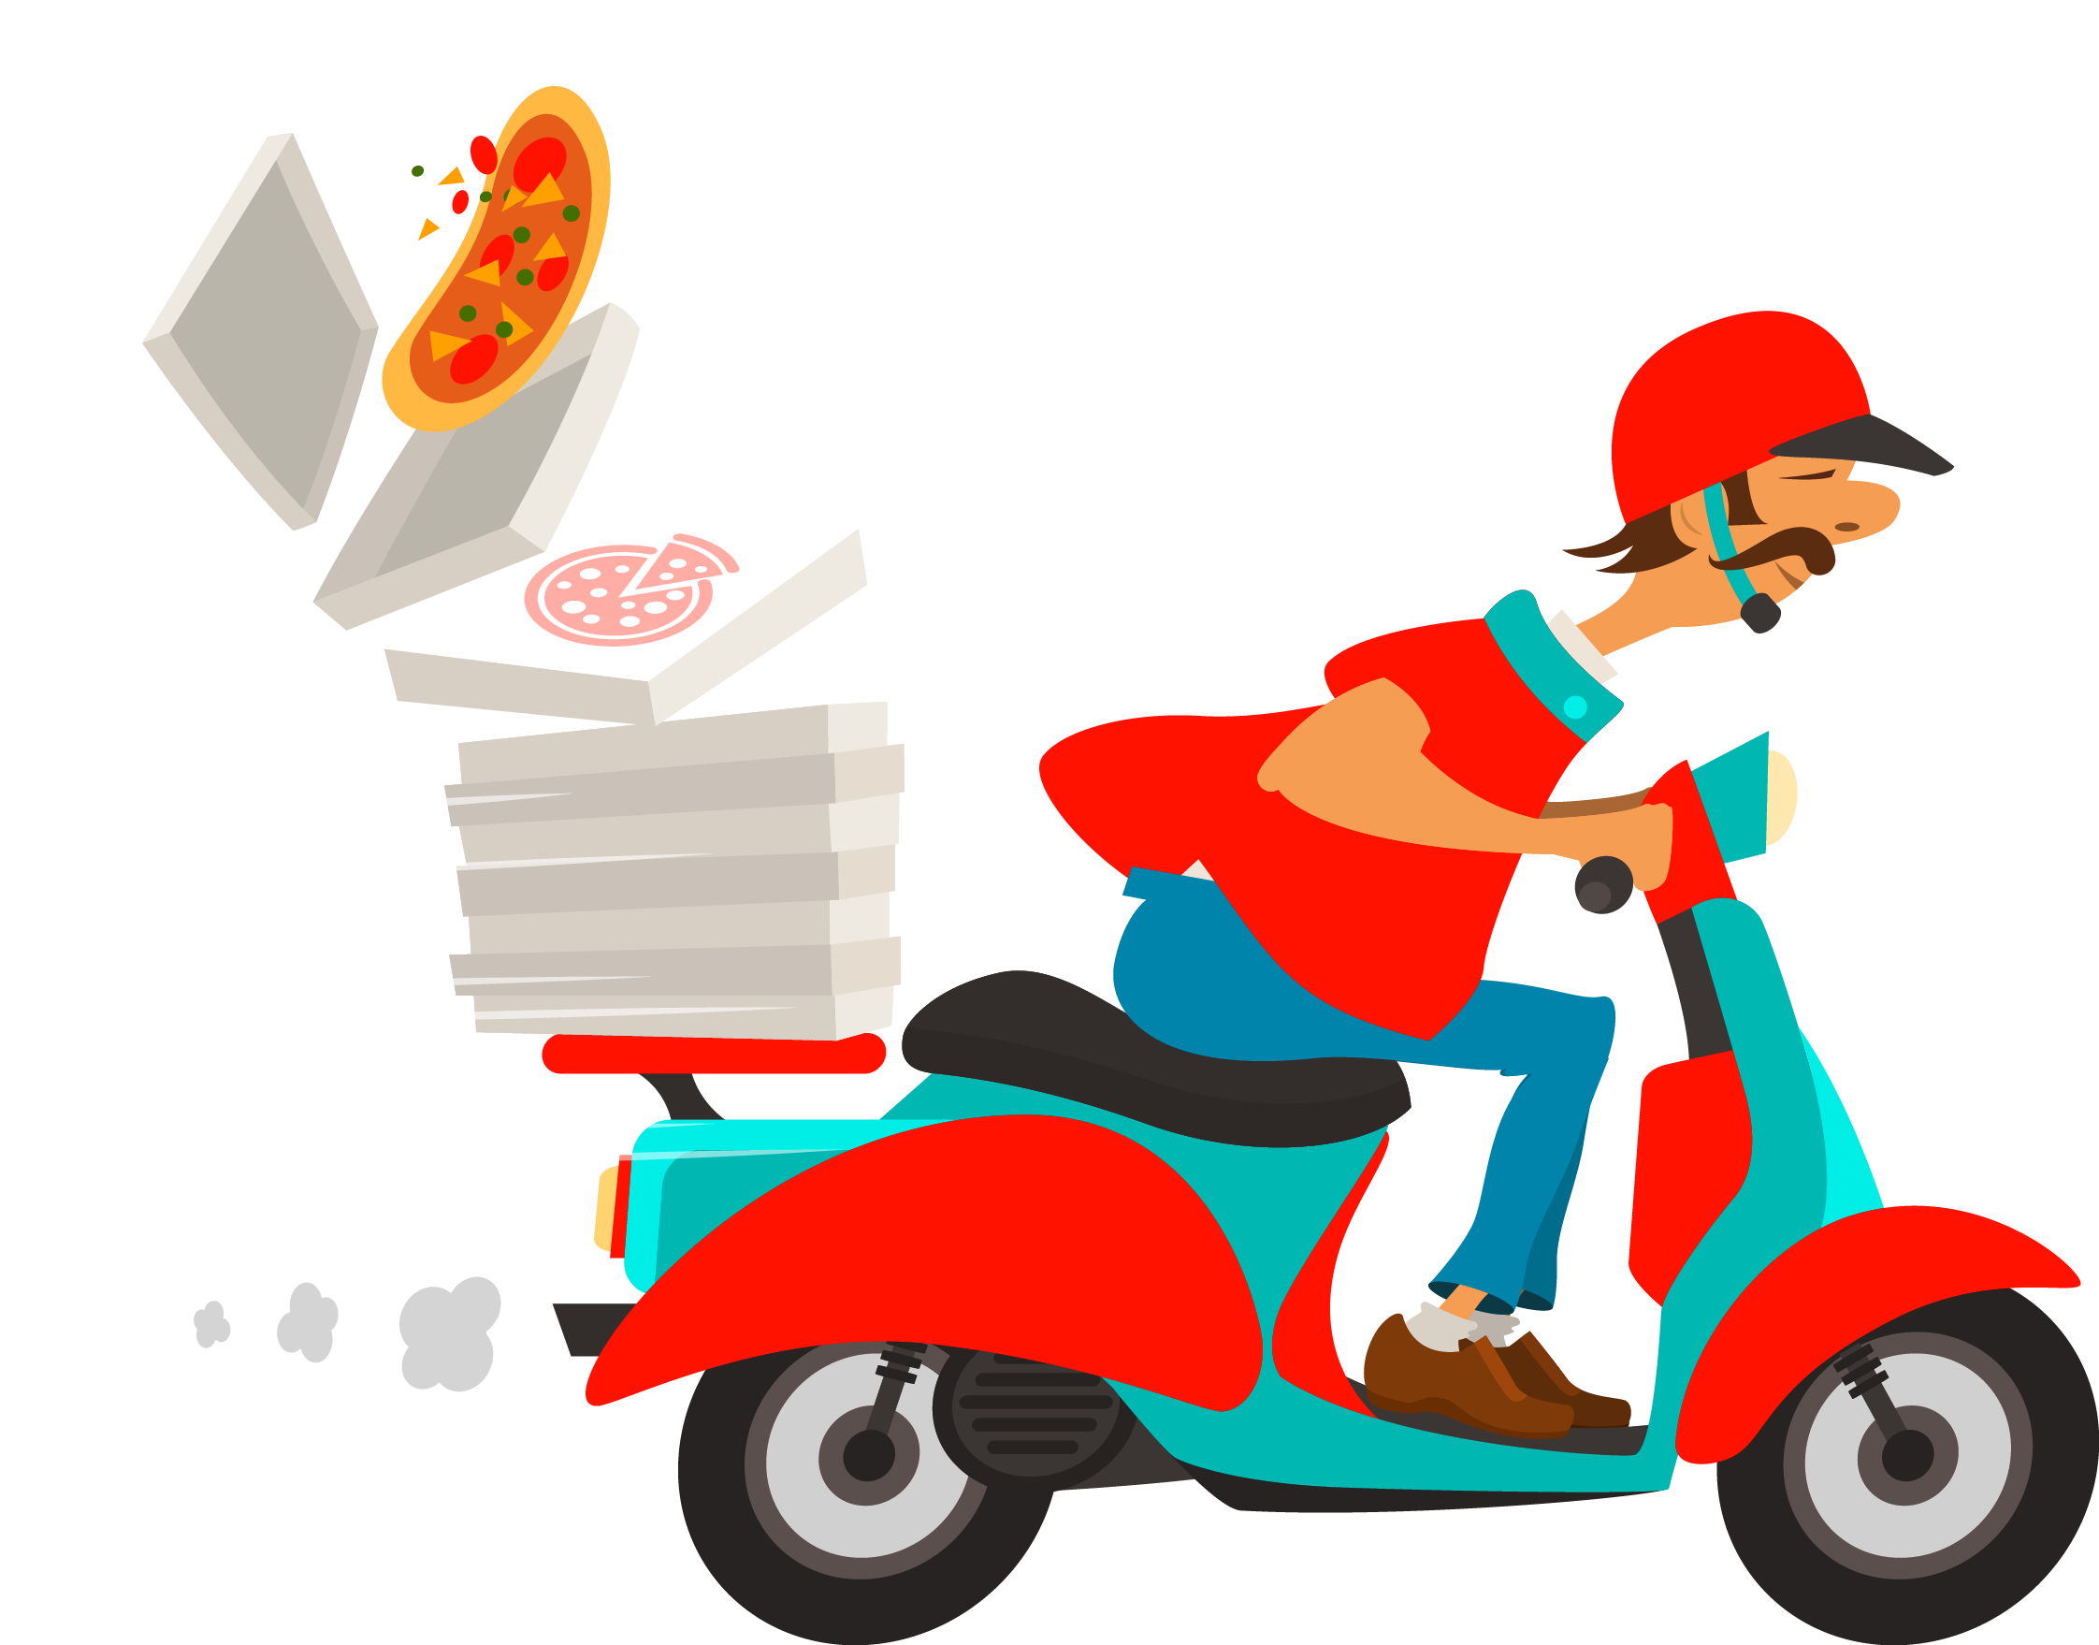
ONLINE FOOD ORDER PREDICTION

Slide 2
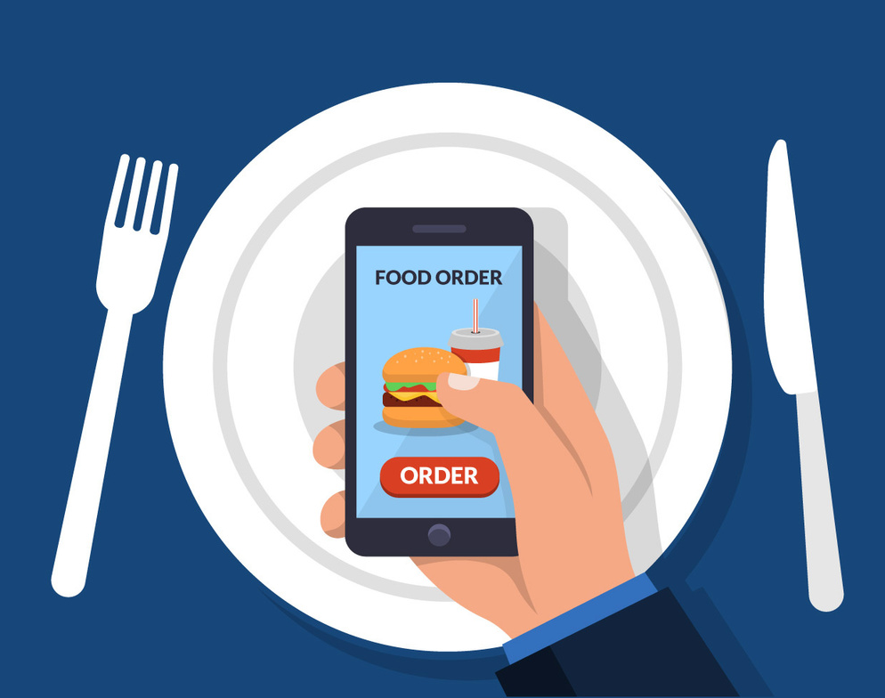
INTRODUCTION
In this presentation, we will explore how data analysis can be used to predict online food orders accurately, leading to improved customer satisfaction. Here we are addressing in this project is predicting whether customers will place the order again or not through various variables.
We aim to leverage advanced machine learning algorithms and data analysis to make predictions more accurate and personalized for each customer. This enables us to stand out in a competitive market and offer a more compelling value proposition to both customers and businesses.

Slide 3
Key terms related to the project
Machine Learning Model: Trained predictive model using customer data for order prediction.
Data Preprocessing: Cleaning and preparing the dataset for machine learning.
Flask: Micro web framework for the user interface.
HTML: Structure for user input and display.
Prediction Endpoint: Web route for making predictions.
Data Persistence: Saving and loading the trained model.
Training Data: Historical dataset for model training.
Testing Data: For evaluating model performance.
Background Image: Enhances the web page's appearance.

Slide 4
OVERVIEW
In the domain of online food ordering, the "Online Food Order Prediction" project is a data-driven approach that leverages advanced machine learning algorithms and data analysis to anticipate whether a customer will place another food order. By extracting valuable insights from customer attributes, historical order data, and feedback, our solution aims to offer a personalized and accurate ordering experience, enhancing customer satisfaction and retention.
DATA SOURCE
https://github.com/rahulmuggalla/Online_Food_Order_Prediction/blob/main/onlinefoods.csv

Slide 5
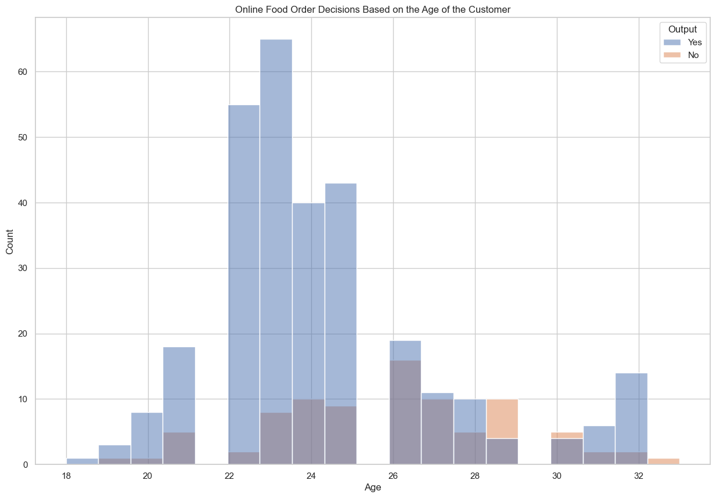
ONLINE FOOD ORDER DECISIONS BASED ON THE AGE OF THE CUSTOMER.
In the histogram we have observed that the age group of 22-25 is more likely to place repeat food orders. This finding suggests that individuals in this age range are frequent users of online food delivery services

Slide 6
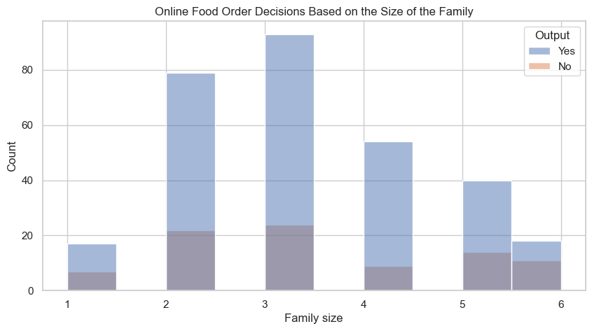
ONLINE FOOD ORDER DECISIONS BASED ON THE FAMILY SIZE OF THE CUSTOMER.
In the histogram we have observed that the families with 2 and 3 members are ordering food often. These can be roommates, couples, or a family of three.

Slide 7
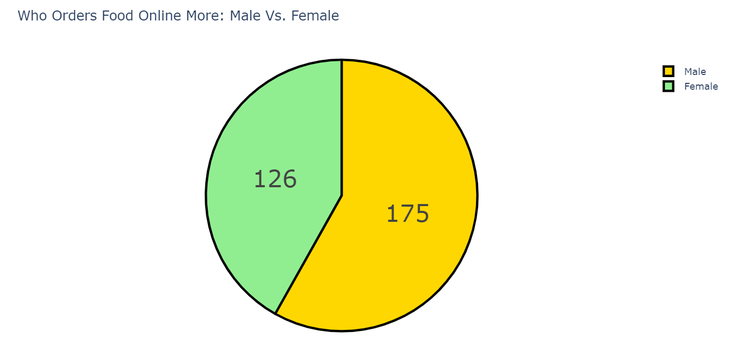
ONLINE FOOD ORDER DECISIONS BASED ON THE GENDER
According to the dataset, male customers are ordering more compared the females.

Slide 8
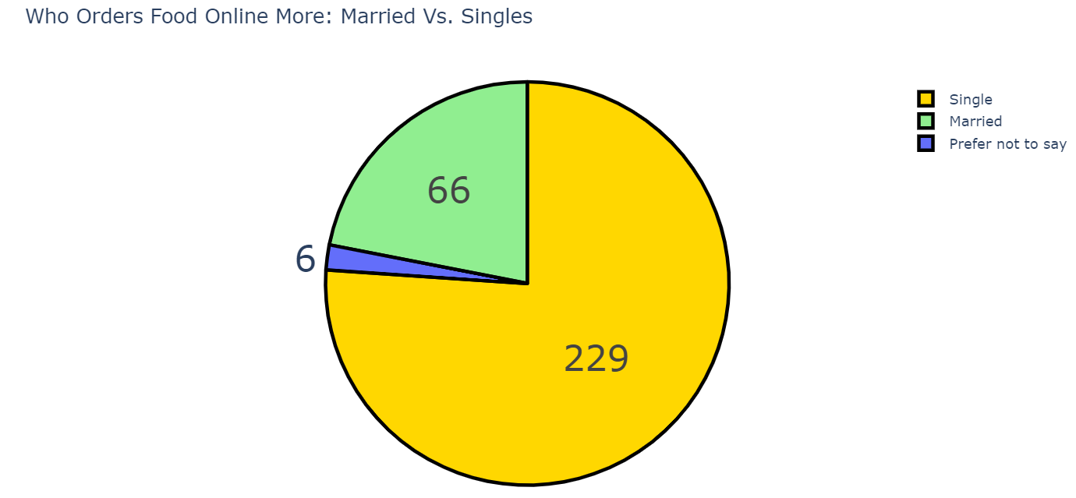
ONLINE FOOD ORDER DECISIONS BASED ON THE MARITAL STATUS OF THE CUSTOMER
According to the above figure, 76.1% of the frequent customers are singles. .

Slide 9
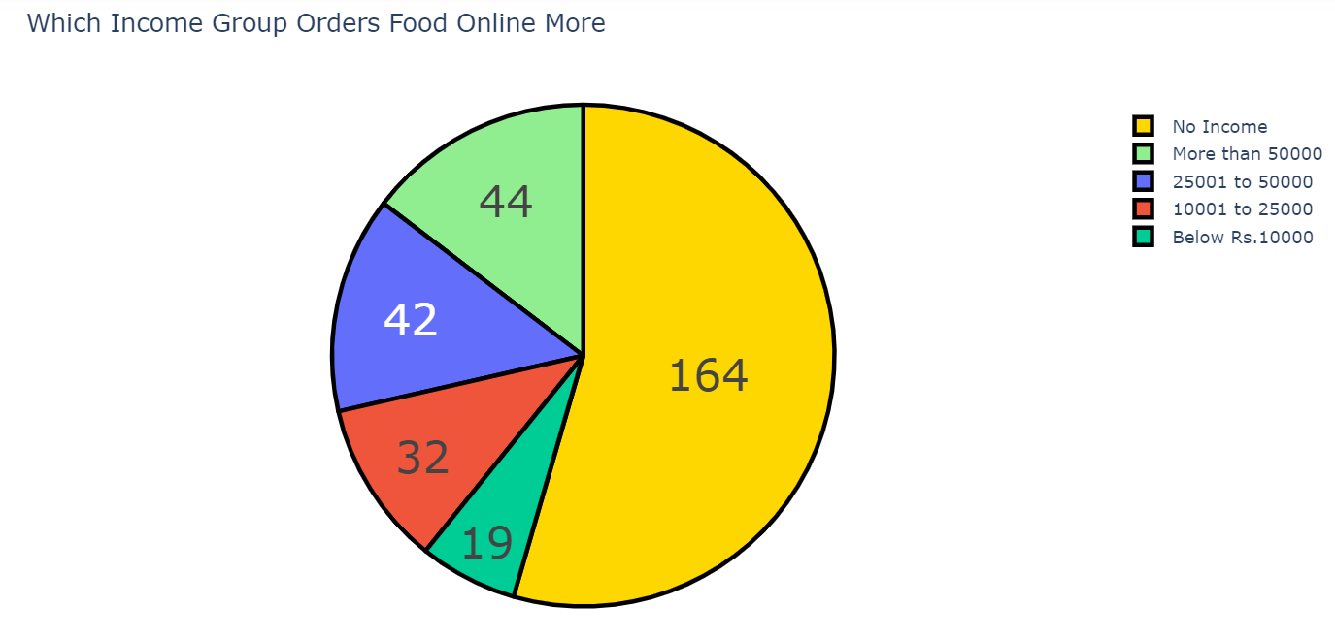
ONLINE FOOD ORDER DECISIONS BASED ON THE INCOME GROUP OF THE CUSTOMERS
According to the above figure, 54% of the customers don’t fall under any income group. They can be housewives or students.

Slide 10
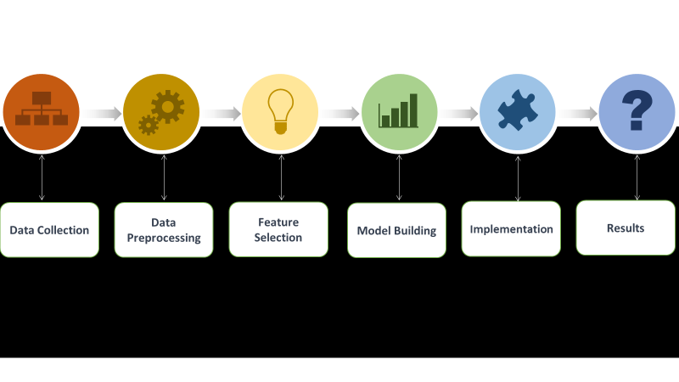
BLOCK DIAGRAM OF THE STEPS IN THE SOLUTION

Slide 11
Explanation of the working of the ML part
In this machine learning model for "Online Food Order Prediction", we import essential libraries like NumPy, pandas, and scikit-learn to work with data and machine learning. After loading the data from a CSV file, we preprocess it by converting categorical features into numerical values.
We split the data into training and testing sets and use a Random Forest Classifier to train the model. Once the model is trained, it's saved to a file for future use. Then load this trained model to make predictions about whether customers will order food online again based on their input features like age, gender, marital status, and more. This predictive model enhances the online food ordering experience by personalizing recommendations and improving customer retention.
We considered two primary evaluation metrics. Accuracy provided an overall measure of prediction correctness, while precision focused on the accuracy of positive predictions, minimizing false positives. These metrics were instrumental in assessing our model's performance in the online food order prediction project.
.

Slide 12
FUTURE PLANS AND BIGGEST LEARNING
Enhanced Recommendations: Improve personalized food recommendations.
Dynamic Pricing: Implement smart pricing strategies.
Inventory Management: Optimize stock levels and reduce waste.
Delivery Optimization: Streamline delivery routes and times.
Customer Segmentation: Targeted marketing and menu options.
Upselling and Cross-selling: Boost revenue with add-on suggestions.
Menu Planning: Adapt the menu for popularity.
User Retention: Prevent customer churn with targeted offers.
Market Expansion: Evaluate new locations or cuisines.
Feedback Analysis: Continually improve based on user feedback.
REFERENCE LINKS
WEBPAGE : CHAT-GPT
CODE : AMAN KHARWAL/GITHUB AND YOUTUBE

Slide 13
THANK YOU
BY,
YASHWANTH Y G - 232BDA43
ROHITH JACOB ABRAHAM - 232BDA44

